Slide 1


Pacific Cascade MS PTSA
Membership Meeting
November 16, 2017

Slide 2

Agenda
Secretary’s Report
School Leadership Report
Officers’ and Directors’ Reports
Parent Education: School Counselor Laura Meserole on Depression and Suicide Recognition and Prevention
2018 Levy Presentation: ISD Superintendent Ron Thiele and School Board Member Lisa Callan

Slide 3
Secretary’s Report
Approval of minutes from Sept. 28, 2017 membership meeting
Awards Committee forming now

Slide 4

School Leadership Report
Report from Principal Dana Bailey

Slide 5
Presidents’ Report
2017 Standards of Affiliation
11/8/2017: the School Board authorized the District Administration to make an offer to purchase three contiguous properties on Iss.-Pine Lake Road for a new elementary school
District is excited about spending the McCleary money

Slide 6
Treasurer’s Report
October Highlights:
$1k in income from Membership, Pass the Hat, and Corporate Matching
$5k in Membership Fees paid
Office Supplies expense is primarily a check reorder - checks should last 2+ years
Book Fair - cash from registers has been deposited, but have not received invoice from Scholastic yet - expect this account to zero out
Fall Social - all expenses paid - program expenses ended up $650 over budget
Curriculum Enrichment Grants approved at Sept. Membership Meeting paid to PCMS

Slide 7
Treasurer’s Report
Bank Statements have been opened and reviewed by a non-signer on the account
AIM Insurance renewed and paid by Nov. 30th
No claims filed against insurance in Sept. or Oct.

Slide 8
Membership
Member Enrollment – CY 743 / PY 839
Membership Percentage – 76% (976 students)
Achieved Bronze Award status for enrolling 50% or more of the previous year’s membership by September 30

Slide 9
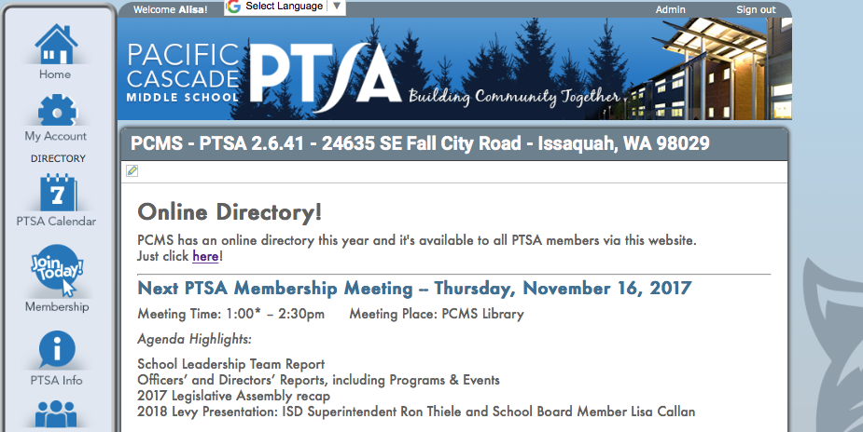
Membership
Online Student Directory is up and running on our website – must be a Member to access this benefit

Slide 10

Programs
Book Fair
$3,226 in sales, plus $100 online
$1,825.00 in Scholastic Dollars earned
for PCMS Library
Teachers were very pleased
  with the books they received
  from their Wish Lists

Slide 11

Programs
Reflections
26 student entries
  13 Visual Arts
  5 Literature
  3 Music Composition
  4 Photography
  1 Dance Choreography
12 Finalists will move on to District
Reception & Art Showcase was Nov. 15
District Reception will be Jan. 9, 2018, from 6:30-8:30pm at Issaquah High School

Slide 12

Programs
Holiday Gift Barn
Drop off days are
Nov. 21, Nov. 29, and
Dec. 1 (before school);
items will be delivered to Pickering Barn
on Dec. 4 & 5
Item list is on our website
Greatest need is gifts for ages 9-18

Slide 13
ASB/Lynx Life
PTSA provided major support for ASB activities in September and October!
Hurricane Relief Fundraiser – September 27 & 29
8 Volunteers, 6 Hours
Counted and recorded donations received
Popcorn/Cookie Dough Fundraiser – October 19th, 26th & 27th
14 Volunteers, 14 Hours
Collected order forms, counted and recorded money from orders
Halloween Social – October 31st
17 Parent Volunteers, 2 Hours
Provided over 50 Costco size boxes of chips, granola bars and gummy bears

Slide 14
Advocacy
Legislative Assembly – October 20-21, 2017
Delegates adopted resolutions on:
  Mental Health Needs for Children
  Trauma Informed Care
  Increasing Access and Affordability of Post-secondary
  /Higher Education Degrees and Certificates
  LGBTQ+ Inclusion
The following legislative issues were added to the “Also Supported” list for the 2018 Legislative Platform (in alphabetical order):
  Addressing the Teacher Shortage
  Best Practices for School Meal Policies
  Career Connected Learning, CTE & Stem
  Dual Credit Equality & Support
  Equity for Highly Capable
  Preventing and Mitigating the Impacts of Gender-based Violence
  School Construction and Class Size Reduction
Read the full recap of the 2017 WSPTA Legislative Assembly at:
https://www.wastatepta.org/2017-wspta-legislative-assembly-recap/

Slide 15
Advocacy
Focus Day – January 29, 2018
State Capitol - Olympia, WA
During each year’s legislative session, Washington State PTA holds its annual Focus Day, which brings members together at the state capitol to advocate for the association’s top five issues. Meetings with legislators, training, rallies and capitol tours are the order of the day.

Slide 16
Parent Education
ParentWiser is a parenting lecture series comprised of local and nationally-known experts who are invited to share the latest information in effective parenting with parents of the Issaquah School District.
Upcoming 2017-2018 Speaker Series events include:
Jan. 24th – Angst Film Documentary with Q&A Panel
Feb. 7th – Stress on the Rise, Dr. Laura Kastner
May 16th – Peaceful Parent, Happy Kids, Dr. Laura Markham
May 17th – Peaceful Parent, Happy Siblings, Dr. Laura Markham
Attendance at ParentWiser events is free for PTSA Members of Issaquah District schools.
Register at ParentWiser.org

Slide 17
Volunteers
PTSA supported these school activities in September and October:
Picture Makeup Day – September 20th
4 Volunteers, 4 Hours
Any student that missed pictures during Lynx Days came to makeup day. Checked students in, crowd control
Picture Retake Day – October 18th
3 Volunteers, 3 Hours
Checked in students that needed their pictures retaken

Slide 18

Issaquah Schools Foundation
All In For Kids Campaign
Giving Tuesday – Nov. 28th
Dining for Kids – Dec. 6th at Chinoise Sushi Bar and Asian Grill @ Issaquah Highlands

Slide 19
New Business
Additional Enrichment Grant Requests
Museum of Flight visiting planetarium program “Under the Night Sky” for all 7th grade science students
Cost: $1,140.00
Money to purchase incentives for the Everyday HEROES program to support PBSES curriculum for all students
Cost: $300.00
Total cost of additional grant requests: $1,440.00

Slide 20
New Business
Volunteer Opportunity -- Nominating Committee
PCMS PTSA is currently looking for three or more people to serve on the Nominating Committee for the 2018/19 Executive Committee.
The Nominating Committee will seek out nominees for the elected board positions and present a slate of candidates to the membership at the March PTSA membership meeting. Members of the Nominating Committee must be elected by the PCMS PTSA membership. Committee members must have been a member of the PCMS PTSA or a local PTA in the Issaquah Council for at least 30 days preceding their election.
If you are interested in serving on the Nominating Committee, please contact the Co-Presidents.

Slide 21
Parent Education
School Counselor Laura Meserole
Depression and Suicide Prevention in teens
2016 Healthy Youth Survey Results for PCMS

Slide 22
Parent Education
2018 Levies
ISD Superintendent Ron Thiele
&
School Board Member Lisa Callan

Slide 23
Adjourned.
Thank you for coming!

